Slide 1
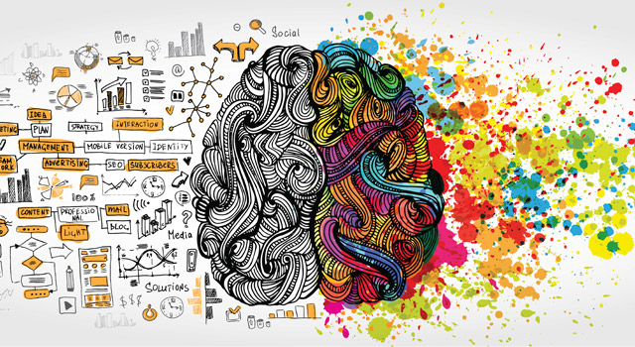
Left and Right Brain

Slide 2
Have you ever wondered why some people seem to be natural artists or mathematicians?
Let’s take a survey to find out which side of the brain you tend to use more!
Color in the best answer to each question on the sheet with the brain on it.
If you’re having trouble deciding, think about what you would do if you were tired and stressed. When you are tired and stressed, your most natural reaction usually comes out. OR use your initional gut reaction.

Slide 3
1A ) I struggle with memorizing and recalling facts.
1B ) I memorize and recall facts easily.
2A ) I like to be spontaneous and I don’t often plan ahead.
2B ) I like to have a plan for my day and my future.
3A ) I talk myself through something new or confusing.
3B ) I like to try to figure out something new or confusing in my head.
4A ) Sometimes I act on impulse, without thinking too much about consequences. 4B ) I often think about rules and consequences before I act or speak.

Slide 4
5A ) I struggle with showing all my work in school.
5B ) I can usually show my thought process on paper.
6A ) I like to read and work in non-traditional places, like the floor or standing up.
6B ) I like to have a certain place for learning, such as a chair or desk.
7A ) I like hands-on, interactive projects.
7B ) I like worksheets, textbooks, and workbooks for learning.
8A ) When faced with a challenging situation, I usually come up with creative or unusual solutions.
8B ) I tend to seek advice or follow the rules when faced with a challenging situation.

Slide 5
9A ) I prefer pictures, charts, and graphs to written words.
9B ) I prefer words to pictures, charts, and graphs.
10A ) I usually act on my feelings.
10B ) I have good self-discipline.
11A ) I don't think about the time when I’m working or playing. 11B ) I plan time for doing most of the activities in my life.
12A ) I prefer fantasy-based and/or mystery books over nonfiction.
12B ) I prefer nonfiction over fiction and fantasy.

Slide 6
13A ) I like to doodle while I work, or I enjoy drawing or coloring.
13B ) I like to focus on the assignment and get it done.
14A ) I tend to skip over directions and immediately “jump in” to assigned work.
14B ) I need to read directions before starting something new.
15A ) I work well with noise, music, or activity in the background.
15B ) I work better when it’s quiet.
16A ) I have a good sense of rhythm or an aptitude for music.
16B ) I have good number sense.

Slide 7
17A ) I have a good sense of direction, and I can read maps well.
17B ) I need navigation systems to help me find somewhere I’ve never been.
18A ) Where I keep things depends on what I'm doing.
18B ) I keep everything in a particular place.
19A ) I tend to procrastinate, and wait until the last minute. 19B ) I like to get assignments done right away.
20A ) I struggle to keep my locker and room at home organized.
20B ) I keep my locker and room at home organized.
21A ) I learn better by demonstration (seeing and doing) than explanation/lecture (hearing).
21B ) I learn better by explanation/lecture (hearing) than demonstration (seeing and doing).

Slide 8
LEFT
Greater ability to solve real- world problems
Better mood/More positive
Greater ability and enjoyment of reading and writing
Ability to think logically, rather than emotionally
Greater mathematical ability
Greater ability to understand and reason with others
Strengthen your Left Brain!
Brain Teasers
Crossword Puzzles
Spelling Activities Math Activities

Slide 9
RIGHT
Have more empathy and sympathy for others
Express your emotions more clearly and positively
More creativity
Better ability to “go with your gut” and intuition when making decisions
More enjoyment of the Arts
Ability to see the “big picture” instead of getting confused with the details
Strengthen your Right
Dance
Paint
Draw Sing/Memorize Songs
Play an instrument
Play strategy games Study maps and charts Acting/Drama
Play Speed Chess
Jigsaw Puzzles
“Measure” items in your head (Spatial Ability)

